Slide 1


Chapter III - 2025
COPYRIGHT (C) 2025, ECLIPSE FOUNDATION

Slide 2
PITCHING SESSION Wheels on fire
COPYRIGHT (C) 2025, ECLIPSE FOUNDATION

Slide 3

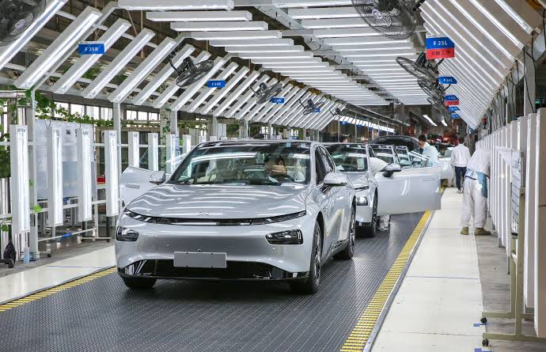
Problem Statement
Difficulties in managing and rolling out new features efficiently
OEMs face fragmented and costly OTA update processes
Updates are slow, unreliable, and hard to scale
High maintenance costs for OEMs
Enhance “Feature as Service” rollout

Slide 4
Initial Idea
Explore Eclipse’s tools to simplify OTA updates and feature management
Focus: provide OEMs with better visibility and control over updates and features
Goal: propose a conceptual solution that could evolve into a full end-to-end platform

Slide 5
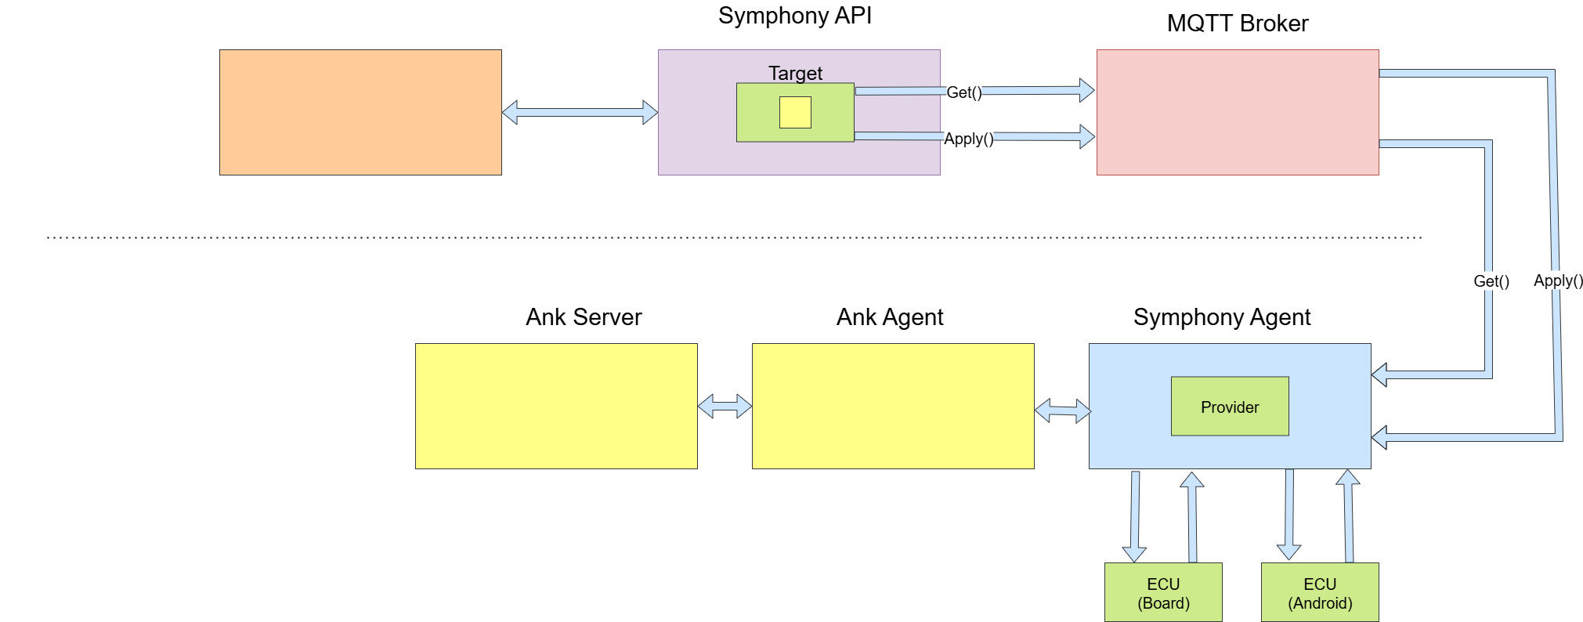
Architecture

Slide 6
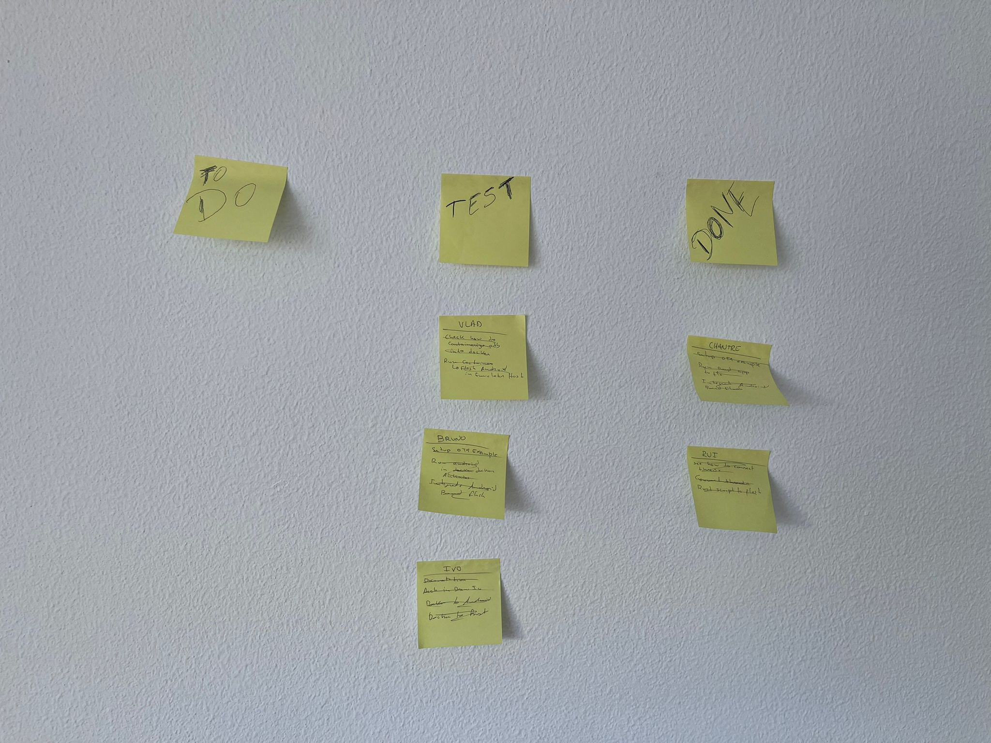
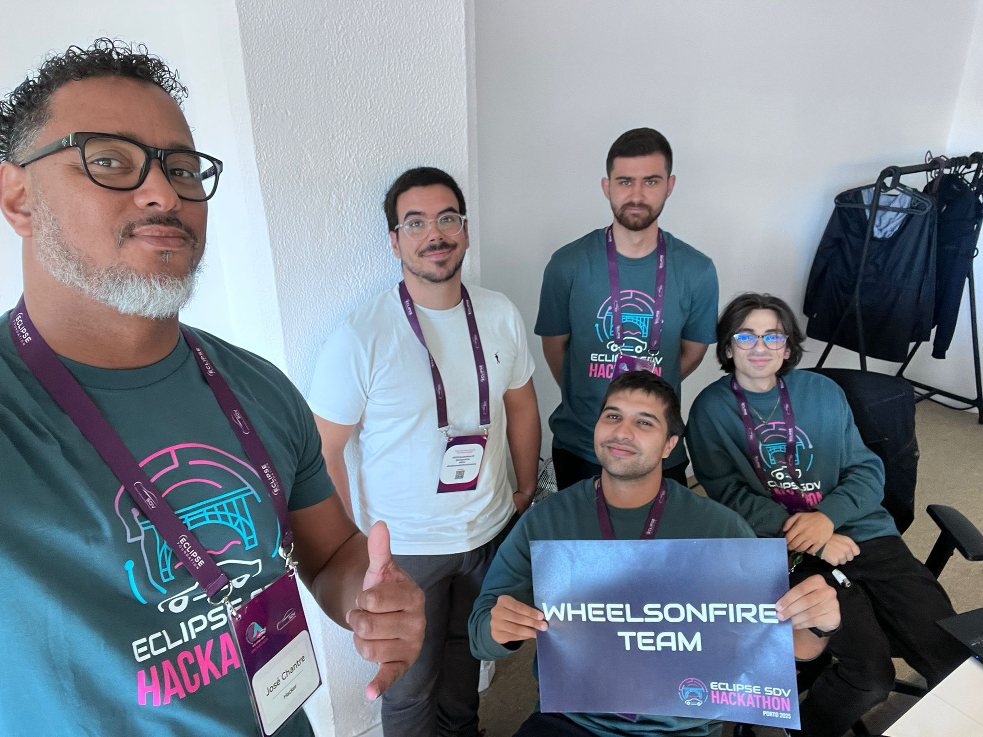
Team Workflow & Task Distribution
Arch & Dev & Team Coordinate
Q.A & Docker
ThreadX
Auto Android
Hack Coach

Slide 7
The Product / Service
OTA Software Platform (backend + management tools)
Manages full software stack updates: firmware, apps, and features
Centralized dashboard for version control, rollout monitoring, and analytics
Modular and scalable for multiple OEMs and vehicle types

Slide 8
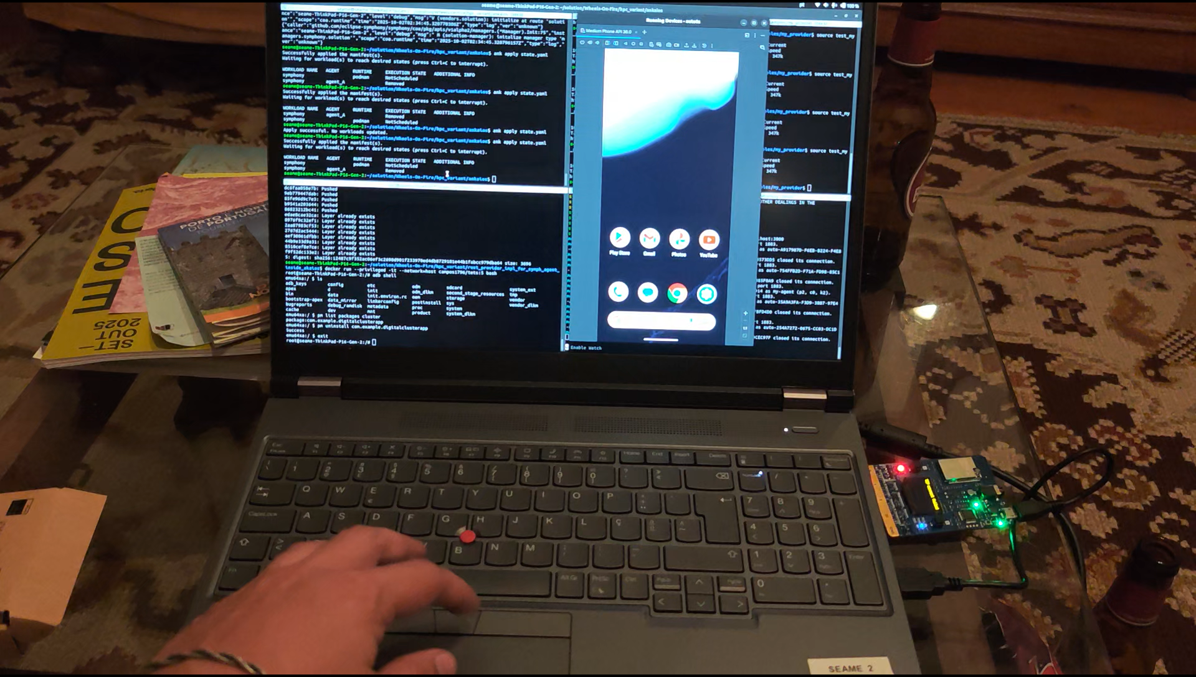
Demo

Slide 9
Problems
Video

Slide 10
Thank You slide
Thank your audience and encourage them to get in touch afterwards.
COPYRIGHT (C) 2025, ECLIPSE FOUNDATION

